Slide 1
Test Automation & Advanced Selenium
Lesson 6: Web Driver Test with Xunit

Slide 2
Lesson Objectives
Introduction to Xunit and Junit
Junit Annotations
Assertions/Verifications with Junit or TestNG
Web Driver Test cases with Junit or TestNG
Test Suite

Slide 3
6.1: Selenium 2.0 – Web Driver Test with Xunit Web Driver Test with Xunit
Is something not missing? We do Testing, where are Test Cases , Test Suite, Verifications, Results , Reports….
Because, Selenium web driver is automation API not testing API
So, combine Selenium automation with testing frameworks, like Xunit

Slide 4
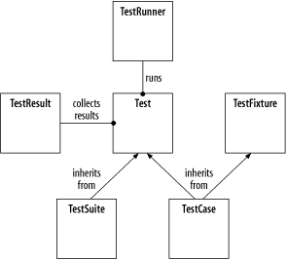
6.1: Selenium 2.0 – Web Driver Test with Xunit Introduction To XUNIT
Xunit is the collective name for several unit testing frameworks that derive their structure and functionality from Smalltalk's SUnit.
The names of many of these frameworks are a variation on "SUnit", usually substituting the "S" for the first letter (or letters) in the name of their intended language ("JUnit" for Java, "RUnit" for R etc.).
These frameworks and their common architecture are collectively known as "Xunit".
All Xunit frameworks share the following basic component architecture:

Slide 5
6.1: Selenium 2.0 – Web Driver Test with Xunit Introduction to JUnit
JUnit is a unit testing framework for the Java programming language.
Important in the development of test-driven development, and is one of a family of unit testing frameworks which is collectively known as Xunit .
JUnit is linked as a JAR at compile-time. The framework resides under package ”junit.framework ” for JUnit 3.8 and earlier, and under package ”org.junit” for JUnit 4 and later.
Notes:
A research survey performed in 2013 across 10,000 Java projects hosted on GitHub found that JUnit, (in a tie with slf4j-api), was the most commonly included external library. Each library was used by 30.7% of projects.

Slide 6
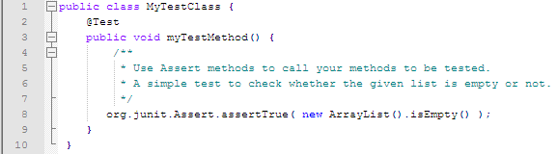
6.1: Selenium 2.0 – Web Driver Test with Xunit Junit – Annotations
@Test:
The Test annotation tells JUnit that the public void method to which it is attached can be run as a test case. To run the method, JUnit first constructs a fresh instance of the class then invokes the annotated method. Any exceptions thrown by the test will be reported by JUnit as a failure. If no exceptions are thrown, the test is assumed to have succeeded.

Slide 7
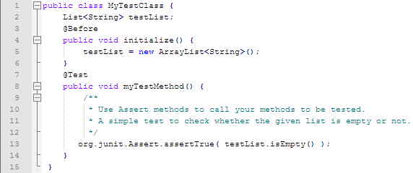
6.1: Selenium 2.0 – Web Driver Test with Xunit Junit – Annotations (Cont.)
@Before:
When writing tests, it is common to find that several tests need similar objects created before they can run. Annotating a public void method with @Before causes that method to be run before the Test method. The @Before methods of super classes will be run before those of the current class.

Slide 8
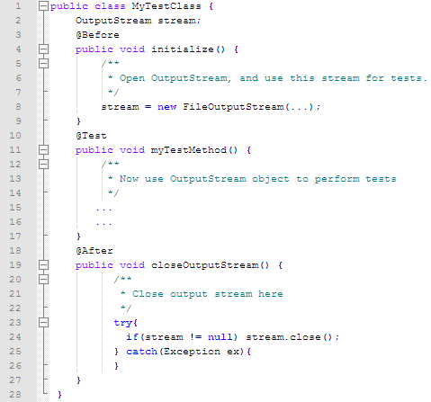
6.1: Selenium 2.0 – Web Driver Test with Xunit Junit – Annotations (Cont.)
@After:
If you allocate external resources in a Before method you need to release them after the test runs. Annotating a public void method with @After causes that method to be run after the Test method. All @After methods are guaranteed to run even if a Before or Test method throws an exception. The @After methods declared in super classes will be run after those of the current class.

Slide 9
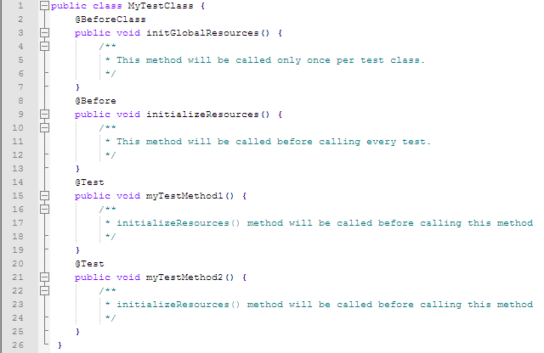
6.1: Selenium 2.0 – Web Driver Test with Xunit Junit – Annotations (Cont.)
@BeforeClass:
Annotating a public static void no-arg method with @BeforeClass causes it to be run once before any of the test methods in the class. The @BeforeClass methods of superclasses will be run before those the current class.
The annotations @BeforeClass and @Before are same in functionality. The only difference is the method annotated with @BeforeClass will be called once per test class based, and the method annotated with @Before will be called once per test based.

Slide 10
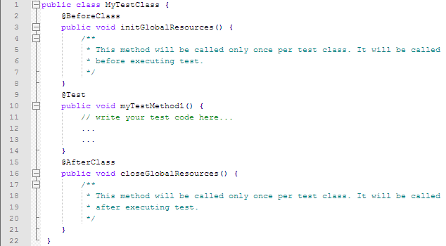
6.1: Selenium 2.0 – Web Driver Test with Xunit Junit – Annotations (Cont.)
@AfterClass:
If you allocate expensive external resources in a BeforeClass method you need to release them after all the tests in the class have run. Annotating a public static void method with @AfterClass causes that method to be run after all the tests in the class have been run. All @AfterClass methods are guaranteed to run even if a BeforeClass method throws an exception. The @AfterClass methods declared in superclasses will be run after those of the current class.

Slide 11
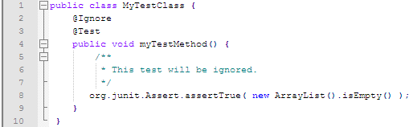
6.1: Selenium 2.0 – Web Driver Test with Xunit Junit – Annotations (Cont.)
@Ignore:
Sometimes you want to temporarily disable a test or a group of tests. Methods annotated with Test that are also annotated with @Ignore will not be executed as tests. Also, you can annotate a class containing test methods with @Ignore and none of the containing tests will be executed. Native JUnit 4 test runners should report the number of ignored tests along with the number of tests that ran and the number of tests that failed.

Slide 12
6.1: Selenium 2.0 – Web Driver Test with Xunit Junit - Assertion
JUnit provides overloaded assertion methods for all primitive types and Objects and arrays.
The parameter order is expected value followed by actual value
Some of the important methods of Assert class are:
void assertEquals(boolean expected, boolean actual) Check that two primitives/Objects are equal
void assertTrue(boolean expected, boolean actual) Check that a condition is true
void assertFalse(boolean condition) Check that a condition is false
void assertNotNull(Object object) Check that an object isn't null
void assertNull(Object object) Check that an object is null

Slide 13
6.1: Selenium 2.0 – Web Driver Test with Xunit Junit – Assertion (Cont.)
void assertSame(boolean condition) The assertSame() methods tests if two object references point to the same object
void assertNotSame(boolean condition) The assertNotSame() methods tests if two object references not point to the same object
void assertArrayEquals(expectedArray, resultArray); The assertArrayEquals() method will test whether two arrays are equal to each other

Slide 14
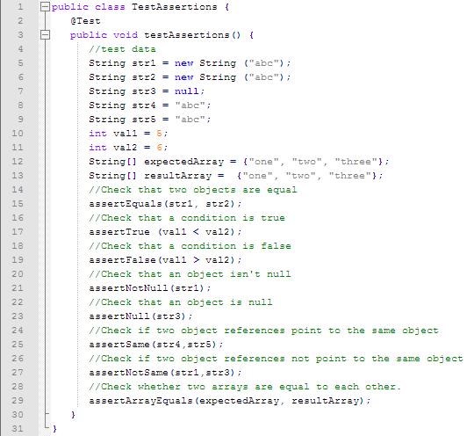
6.1: Selenium 2.0 – Web Driver Test with Xunit Junit – Assertion Example

Slide 15
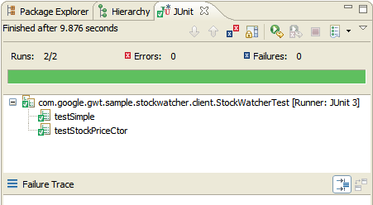
6.1: Selenium 2.0 – Web Driver Test with Xunit Junit – Reports
Junit report collects individual XML files
Merge the individual XML files generated by the JUnit task and eventually apply a stylesheet on the resulting merged document to provide a browsable report of the test cases results

Slide 16
6.1: Selenium 2.0 – Web Driver Test with Xunit Web Driver Test cases with TestNG
Open source Java testing framework, not limited to unit tests
Designed to be better than JUnit, especially when testing integrated classes
Supports parameterized tests out-of-the-box (in much more convenient way than JUnit does)
Facilitates running multi-threaded tests
Allows to express dependencies between test methods
Integrates very well with the build tools: Ant, Maven and Gradle
Supported by all major IDEs
Can be used with different JVM languages (e.g. Java, Groovy, Scala) and cooperates with many quality and testing tools (e.g. code coverage tools, mocking libraries, matchers libraries)
Some popular solutions - e.g. Spring Framework - provide means to facilitate testing with TestNG

Slide 17
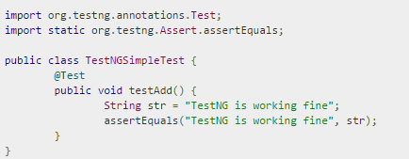
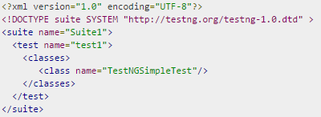
6.1: Selenium 2.0 – Web Driver Test with Xunit Web Driver Test cases with TestNG (Cont.)
Writing a test is typically a three-step process:
Write the business logic of your test and insert TestNG annotations in your code.
Add the information about your test (e.g. the class name, the groups you wish to run, etc...) in a testng.xml file or in build.xml.
Run TestNG
Test Case Example testng.xml File

Slide 18
6.1: Selenium 2.0 – Web Driver Test with Xunit TestNG Annotations
Annotation | Description
@Test | The annotation notifies the system that the method annotated as @Test is a test method
@BeforeSuite | The annotation notifies the system that the method annotated as @BeforeSuite must be executed before executing the tests in the entire suite
@AfterSuite | The annotation notifies the system that the method annotated as @AfterSuite must be executed after executing the tests in the entire suite
@BeforeTest | The annotation notifies the system that the method annotated as @BeforeTest must be executed before executing any test method within the same test class

Slide 19
6.1: Selenium 2.0 – Web Driver Test with Xunit TestNG Annotations (Cont.)
@AfterTest | The annotation notifies the system that the method annotated as @AfterTest must be executed after executing any test method within the same test class
@BeforeClass | The annotation notifies the system that the method annotated as @BeforeClass must be executed before executing the first test method within the same test class
@AfterClass | The annotation notifies the system that the method annotated as @AfterClass must be executed after executing the last test method within the same test class
@BeforeMethod | The annotation notifies the system that the method annotated as @BeforeMethod must be executed before executing any and every test method within the same test class

Slide 20
6.1: Selenium 2.0 – Web Driver Test with Xunit TestNG Annotations (Cont.)
@AfterMethod | The annotation notifies the system that the method annotated as @AfterMethod must be executed after executing any and every test method within the same test class
@BeforeGroups | The annotation notifies the system that the method annotated as @BeforeGroups is a configuration method that enlists a group and that must be executed before executing the first test method of the group
@AfterGroups | The annotation notifies the system that the method annotated as @AfterGroups is a configuration method that enlists a group and that must be executed after executing the last test method of the group

Slide 21
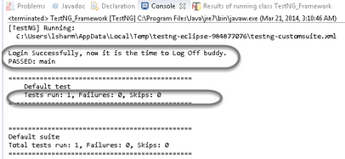
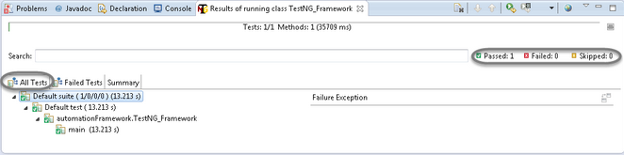
6.1: Selenium 2.0 – Web Driver Test with Xunit TestNG Result
TestNG result is displayed into two windows as shown below:
Console Window
Testing Result Window
a
b

Slide 22
6.1: Selenium 2.0 – Web Driver Test with Xunit TestNG Reports
Generates a different type of report for test execution
Whenever TestNG is run, HTML and XML reports are generated by default in the directory
For implementing a reporting class, the class has to implement an org.testng.IReporter interface
Has its own reporter objects which are called when whole suite run ends
Object containing the information of the whole test run is passed on to the report implementations
Default implementations are:
Main
Failed Reporter
XML Reporter
EmailableReporter2
JUnitReport Reporter
SuiteHTML Reporter

Slide 23
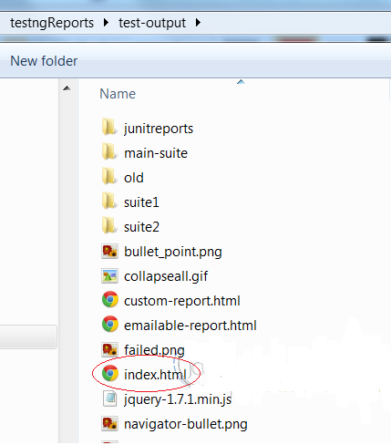
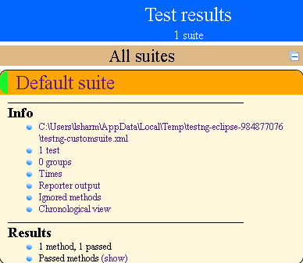
6.1: Selenium 2.0 – Web Driver Test with Xunit TestNG Reports
In Main report layout ,test-output directory contains HTML reports like an index.html file, that is the entry point to the TestNG HTML report.
The top-level report gives us a list of all the suites that were just run, along with an individual and compound total for each passed, failed, and skipped test.

Slide 24
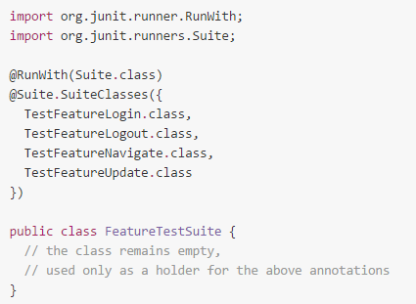
6.1: Selenium 2.0 – Web Driver Test with Xunit Test Suite(JUnit)
Test suite means bundle a few unit test cases and run it together.
In JUnit, both @RunWith and @Suite annotation are used to run the suite test.
Example of Test Suite in JUnit:
Notes:
Aggregating tests in suites:
Using Suite as a runner allows you to manually build a suite containing tests from many classes. It is the JUnit 4 equivalent of the JUnit 3.8.x static Test suite() method. To use it, annotate a class with @RunWith(Suite.class) and @SuiteClasses(TestClass1.class, ...). When you run this class, it will run all the tests in all the suite classes.
Example:
The class above is a placeholder for the suite annotations, no other implementation is required.
Note : @RunWith annotation, which specifies that the JUnit 4 test runner to use is org.junit.runners.Suite for running this particular test class. This works in conjunction with the @Suite annotation, which tells the Suite runner which test classes to include in this suite and in which order.

Slide 25
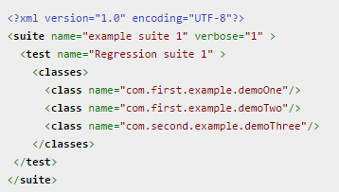
6.1: Selenium 2.0 – Web Driver Test with Xunit Test Suite(TestNG)
Example:
In the above xml
class name has been specified as “com.first.example.demoOne” and “com.first.example.demoOne” which are in “com.first.example” package
Class name demoThree is in package “com.second.example.”
Notes:
We need to specify the class names along with packages in between the classes tags.
All the classes specified in the xml will get executes which have TestNG annotations.

Slide 26
Summary
In this lesson, you have learnt
In this lesson, you have understood that Xunit is the latest technology for unit testing.
JUnit is an open source framework which is used for writing & running tests.
Junit Provides Annotation to identify the test methods, Assertions for testing expected results and also provides Test runners for running tests.
You have also understood how to execute Web Driver with Junit ,Testing and Test Suite.
Test suite enables you to execute the bundle of unit test cases at a time .
The only drawback of Xunit is:
Lack of documentation- Compared to MSTest and NUnit, xUnit.NET lacks documentation
Notes:
Add the notes here.

Slide 27
Review Question
Question 1
Select the Annotation which is NOT part of JUnit Annotations
@After
@After or Before
@Before
@AfterClass
Question 2: True/False
The Selenium web driver is automation API not testing AP
Question 3: Fill in the Blanks
The assertSame() methods tests if two object references point to the ______ .

